Slide 1

Congratulations

Slide 2
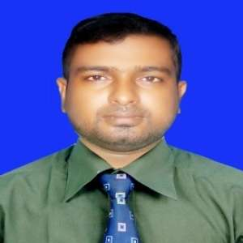
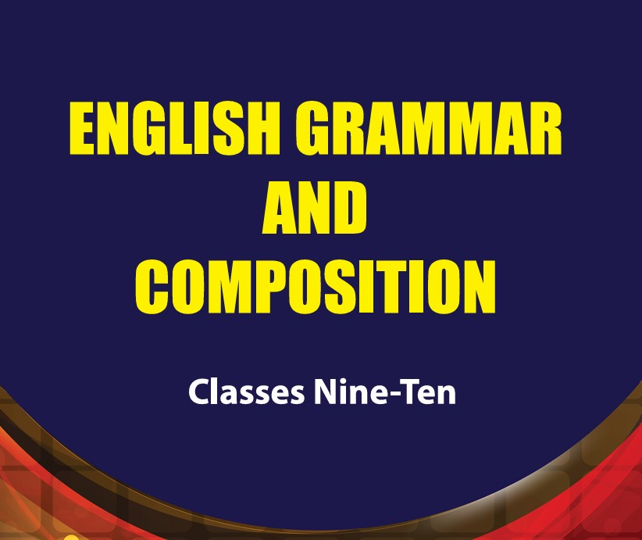
Teacher’s Identity & Lesson Contacts
Name: Anik Kumar Dhar
Assistant Teacher
Saroatali Ibrahim Nur Mohammad High School
Boalkhali, Chattogram.
Mobile: 01864690707, Email: akdpkdiai@gmail.com
Subject: English Grammar and Composition
Lesson: Verbs and Tenses
Right Form of Verbs
Class: Nine & Ten

Slide 3
Learning Outcomes
By the end of the lesson learners will be able to:
talk about Verbs (Speaking skills).
b) read a text and find out the correct form of verbs.
c) use the right forms of verbs

Slide 4
Rule 01
Present Indefinite Tense এর subject যদি third person singular number হয় তাহলে verb এর শেষে s, es যোগ হবে। কিন্তু অন্য কোন tense এর ক্ষেত্রে হবে না।
He eats rice.
He plays football.
Word | Singular | Plural
Noun | s, es যোগ হবে না | s, es যোগ হবে
Pen | Pen | Pens
Verb | s, es যোগ হবে | s, es যোগ হবে না
Eat/play | Eats/plays | Eat/play

Slide 5
Rule 02
Present Indefinite Tense এর subject যদি plural number হয় তাহলে verb এর শেষে s/es যোগ হবে না।
They play football.
They eat rice.
Word | Singular | Plural
Noun | s, es যোগ হবে না | s, es যোগ হবে
Pen | Pen | Pens
Verb | s, es যোগ হবে | s, es যোগ হবে না
Eat/play | Eats/plays | Eat/play

Slide 6
Present Indefinite Tense এর subject, third person singular number হলেও সেটি যদি negative sentence হয় তাহলে does not ব্যবহৃত হবে। তখন verb এর শেষে s/es যোগ হবেনা।
Rule 03
He does not go to school.
Anik does not eat rice.

Slide 7
Modal Auxiliary verb এর পরে verb এর present form বসে এবং verb এর সাথে কোন কিছু যোগ হয় না।
Rule 04
He can do the work.
I shall go to the school.
You must come home.
He should study hard.

Slide 8
Model Verb
Shall
Dare
Need
Ought to
Must
Might
May
Could
Can
Would
Will
Should
Have to

Slide 9
Sentence টি passive voice হলে এবং modal auxiliary verb এর পরে be + past participle form of verb বসে।
Rule 05
It can be done by you.
All the fruits could be taken.

Slide 10
বাক্যটি যদি universal truth (চিরন্তন সত্য) হয়, habitual fact (অভ্যাসগত কাজ) বোঝায় তাহলে present indefinite tense হবে।
Rule 06
The sun rises in the east.
Ice floats on water.

Slide 11

drive | solve | create | suffer | occur
reach | cause | carry | violate | give
Traffic jam is a common affair in big cities of our country. Increasing number of vehicles (a) — traffic jam. Mainly it (b) — in the congested areas. Overtaking tendency also (c) — traffic jam. Some drivers (d) — the traffic rules and (e) — carelessly. It (f) — a lot of pains to the people. Ambulances (g) — patients cannot (h) — hospital timely. Students and office-going people also (i) — due to traffic jam. This problem should be (j) — immediately.

Slide 12


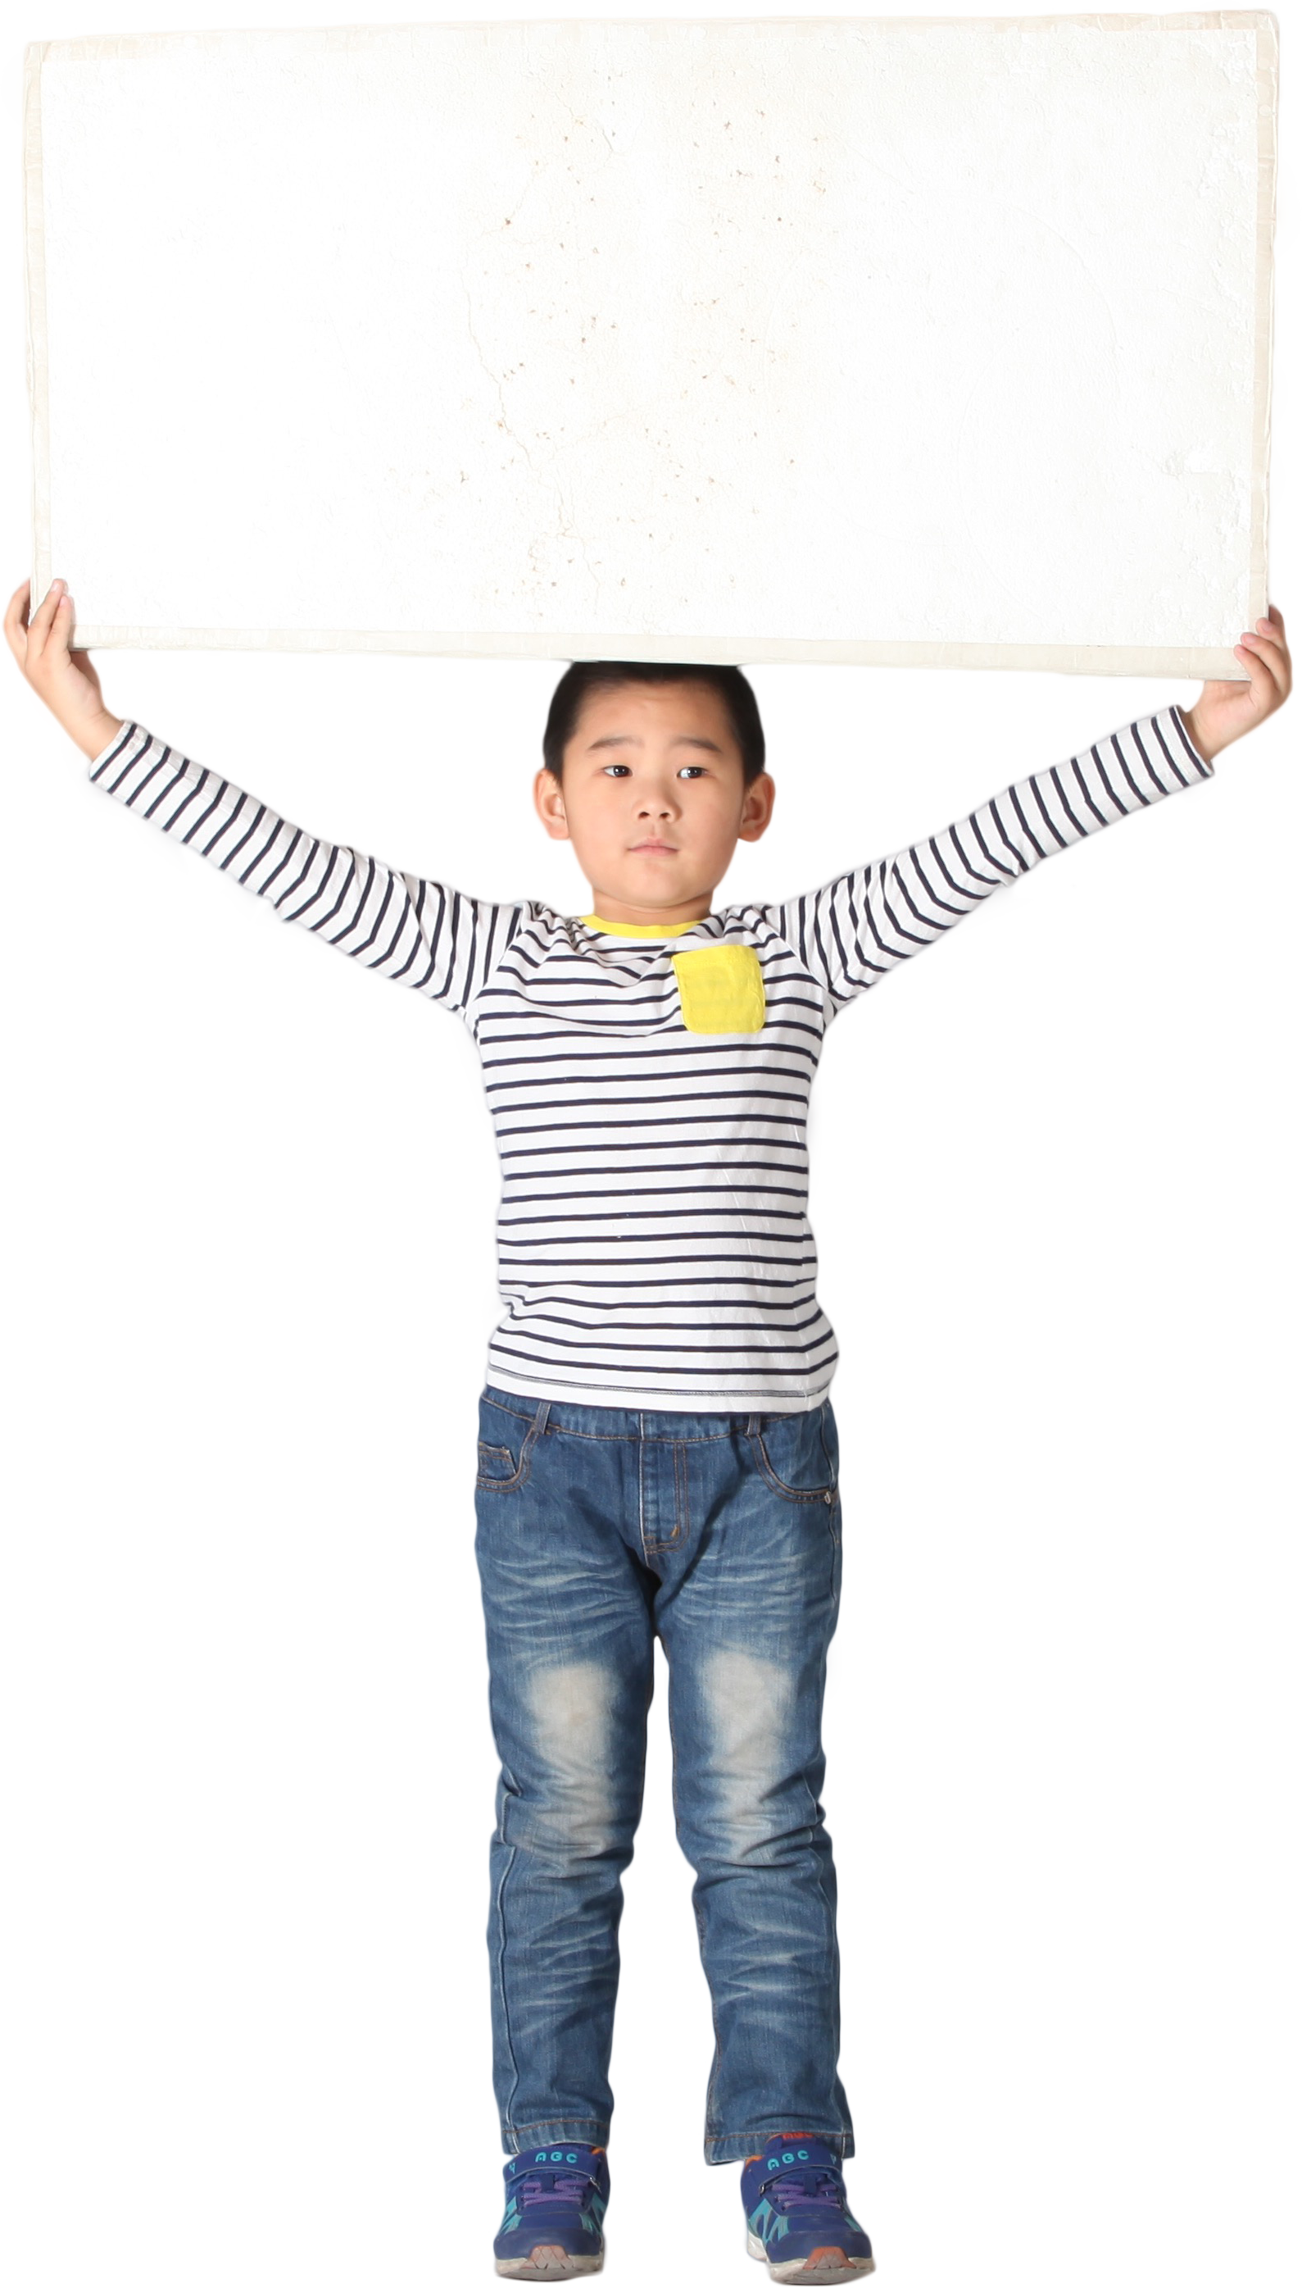

Slide 13
01. Traffic jam is a common affair in big cities of our country. Increasing number of vehicles (a) — traffic jam.
Answer: causes
Rules: Singular Subject+ Singular Verb
02. Mainly it (b) — in the congested areas. Answer: occurs
Rules: Singular Subject+ Singular Verb

Slide 14
03. Overtaking tendency also (c) — traffic jam.
Answer: creates
Rules: Singular Subject+ Singular Verb
04. Some drivers (d) — the traffic rules and (e) — carelessly. Answer: (d) violate (e) drive
Rules: Plural Subject+ Plural Verb
05. It (f) — a lot of pains to the people.
Answer: causes
Rules: Singular Subject+ Singular Verb

Slide 15
06. Ambulances (g) — patients cannot (h) — hospital timely. Answer: carrying , reach
Rules: Models+ Verb present form
07. Students and office-going people also (i) — due to traffic jam. Answer: suffer
Rules: Plural Subject+ Plural Verb
08. This problem should be (j) — immediately. Answer: solved
Rules: Models+be+ Verb past participle

Slide 16

Class Test
Choose the best answer
01. The sun …………. brightly .
( shines/ shine/ shining)
02. We ………..… to the park yesterday.
(go/ went/ going)
03. They ……………..football last night.
(play/ played/ playing)
04. She ………… hard for the exam.
(studies/ study/ studied)

Slide 17

Fill The Gap with appropriate verbs
You must have (a) — the name of Kazi Nazrul Islam. He (b) — our national poet. He (c) — as a rebel poet as well. He (d) — into a poor family. But dire needs could not (e) — his potentiality. When the First World War broke out, he (f) — the army. After the war, he (g) — to write poems. At that time, his poems and songs (h) — people against oppression. He (i) — the Shelley of Bangla literature. We should (j) — him for his great deeds.

Slide 18

Thank You

